Slide 1
Work Opportunity
Tax Credits
How Much Money Are
You Leaving on the Table?

Slide 2
We are the workforce development system serving St. Bernard, Plaquemines, and St. Tammany. We connect employers and job seekers and prepare the workforce to meet the needs of employers.
We are THE workforce experts

Slide 3
WOTC – 6 Steps to Success
Work
Opportunity
Tax
Credit
Provides a Tax Incentive for the Prospective Employer
Improves the Employment Prospects of Disadvantaged Individuals

Slide 4
What is WOTC ?
Work Opportunity Tax Credit
A federal tax credit available to employers who invest in American job seekers who have consistently faced barriers to employment. Employers may meet their business needs and claim a tax credit if they hire an individual who is in a WOTC targeted group

Slide 5
Benefits for Hiring from Special Populations
Credits range between $1,200 to $9,600
EX Offenders
Persons With Disabilities
Designated
Communities
Long-Term Unemployed
Veterans
TANF Recipients

Slide 6
Who Can Receive WOTC
Federal Income Tax Credit that reduces the federal tax liability of ‘private for profit’ Employers
501 (C) (3) non-profits can qualify for reduction in Social Security employment payments
To qualify, Employers must hire qualified eligible individuals from any one of ten different target groups

Slide 7
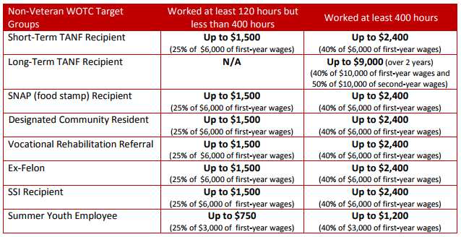
Tax Credit Maximum Amounts
www.dol.gov/sites/dolgov/files/ETA/wotc/pdfs/WOTC_EligibilityDeskAid.pdf

Slide 8
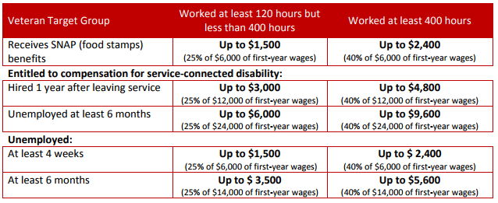
Tax Credit Maximum Amounts

Slide 9
WOTC Application Process
1 One-time online
Registration
2 Two
Forms
6 Submit to IRS
6 Steps
3 Collect Docs
5 Receive Certificate
4 Submit
to LWC

Slide 10
Step 1: Register
www.laworks.net/wotc

Slide 11
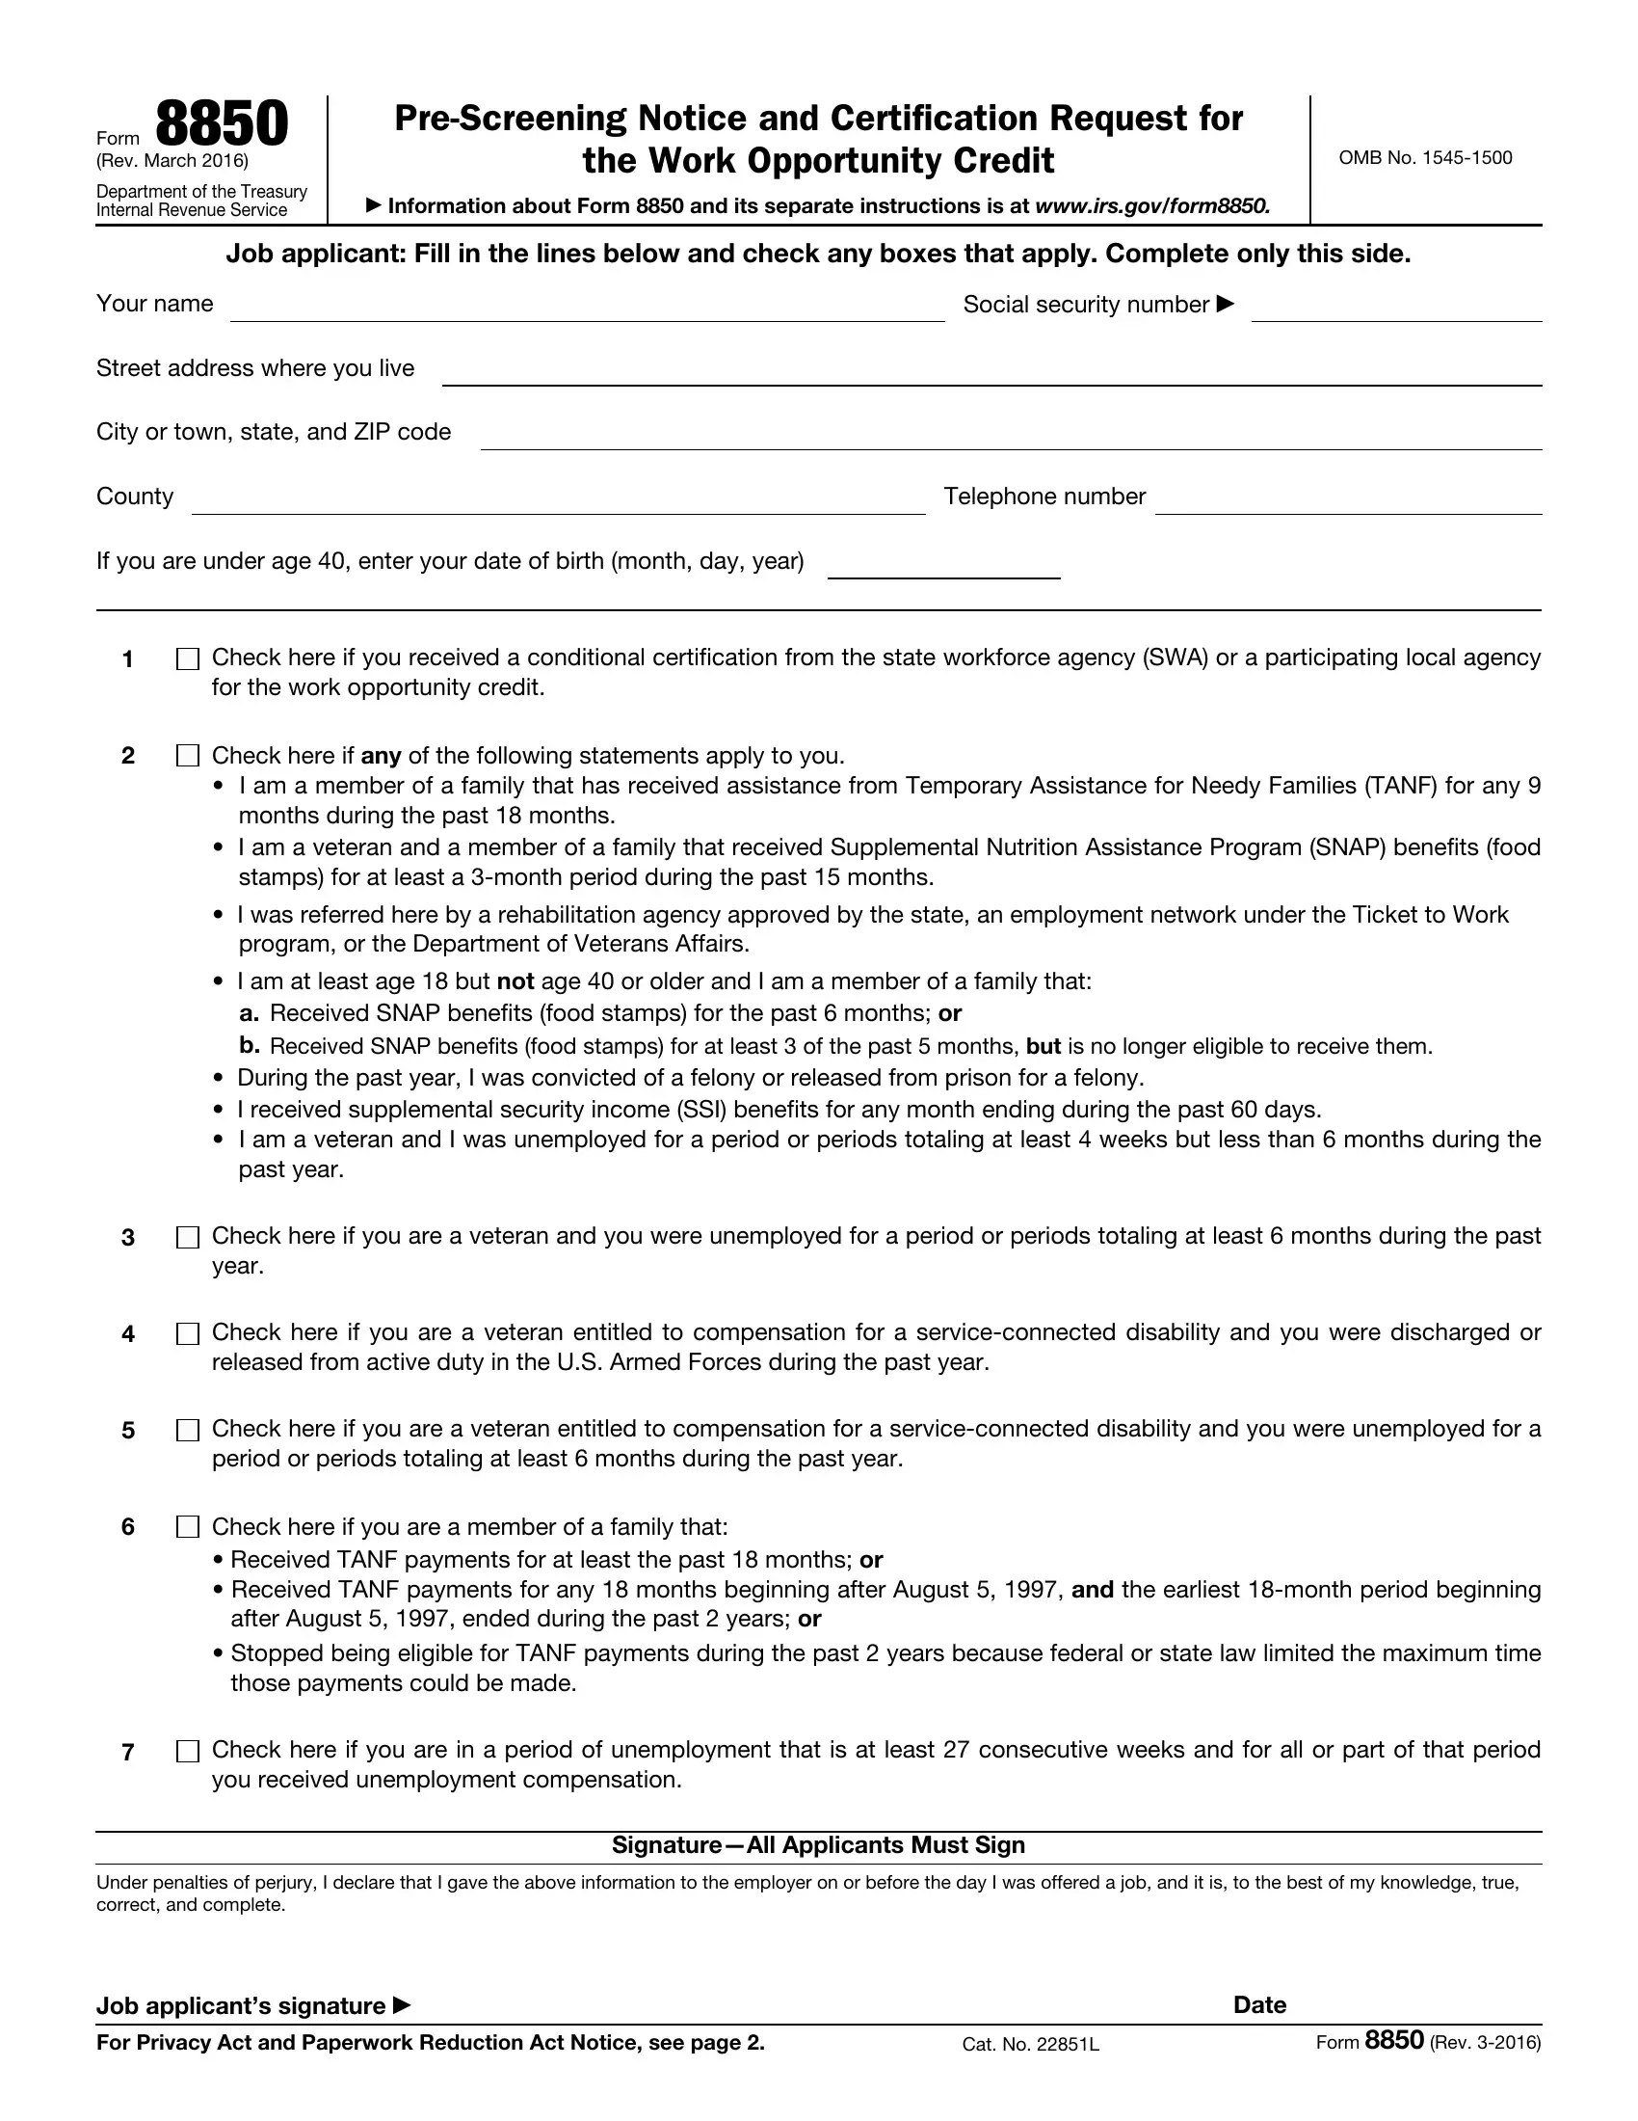
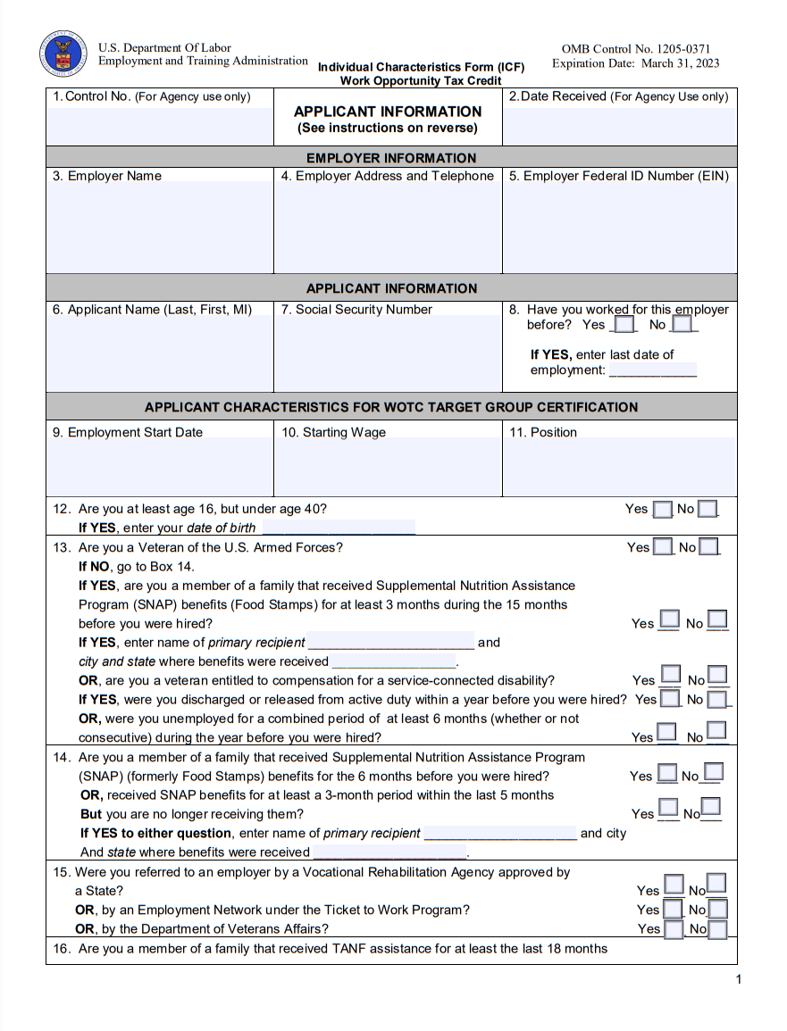
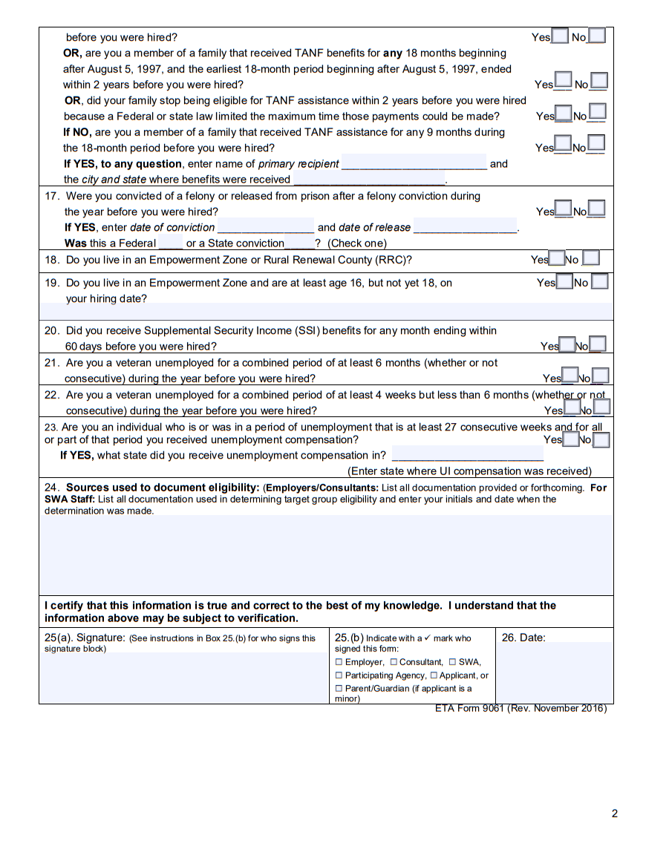
Step 2: Applicant Completes Forms
IRS Form 8850
Pre-Screening Notice &
Certification Request for WOTC
ETA Form 9061
Individual
Characteristics Form
Electronically File no later than 28 Days after new hire’s start date
Original Signatures required by Applicant & Employer
Forms closely resemble each other and provides the employer with an idea of the applicant’s eligibility status

Slide 12
*If Applicable
Step 3: Supporting Documentation
Social Security Card
Driver’s License
W-4
Letters from SSA*
DD 214 *
Letter from Dept of Corrections*
Make copies of documentation used to determine Target Group

Slide 13
Step 4: Submit to Louisiana Workforce Commission
Submit information online within 28 days after Hiring Date and retain….
Original completed IRS Form 8850
Original completed ETA Form 9061
Copies of Supporting Documentation
Retain documentation with original signatures in your personnel file
www.laworks.net/wotc

Slide 14
Step 5: Certification Confirmation
If the application is certified as eligible, LWC will send ETA Form 9063, “WOTC Employer Certification”
If not certified as eligible for the tax credit, you’ll be notified

Slide 15
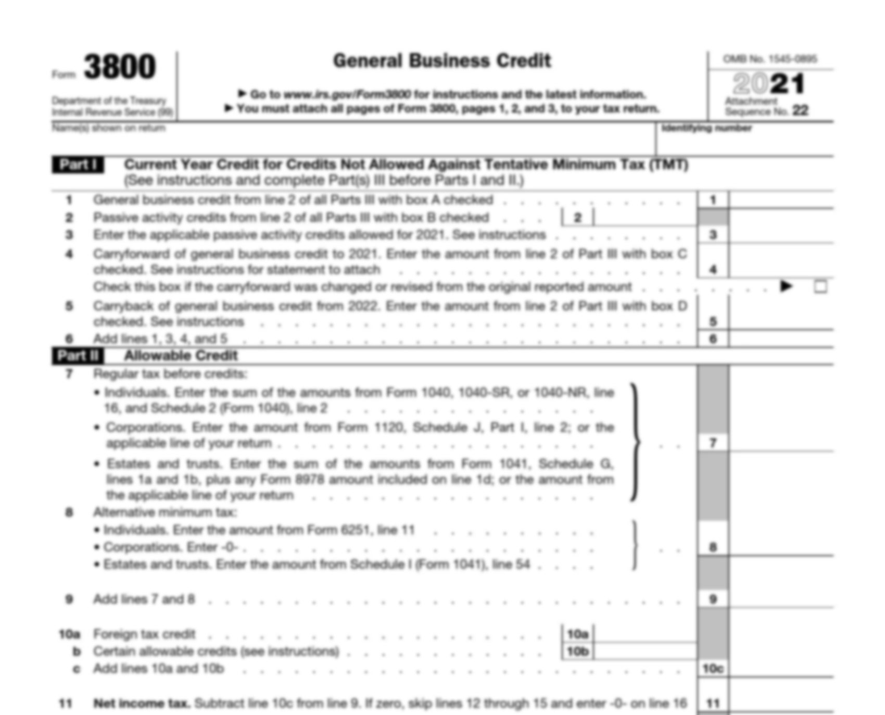
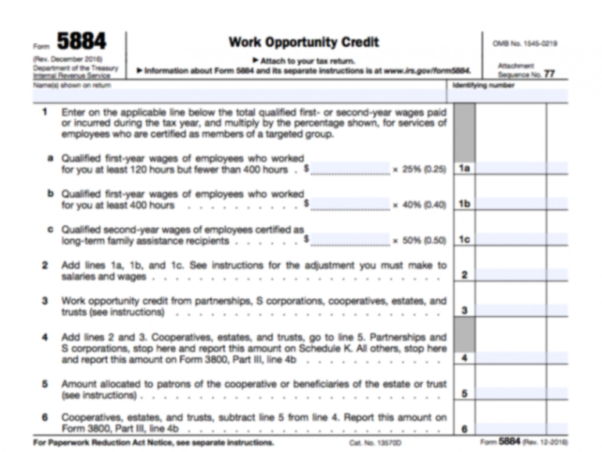
Step 6: Submit to IRS
Employer claims credit on their income tax return
The credit is first figured on IRS Form 5884 and then becomes a part of the general business credit claimed on IRS Form 3800

Slide 16
Let’s Recap WOTC
Register your company for a Louisiana WOTC online account at https://www.laworks.net/wotc
Have new hires complete Forms 8850 and 9061
Upload new employee information (from the 8850 and 9061) to the state WOTC online system at the same time as you enter New Hire Reporting (this is done at 20 days which will ensure you meet the 28 day deadline for WOTC)
Make IRS Form 8850 and ETA Form 9061 in your regular hiring packet

Slide 17
Want More Answers?
Contact
225-342-2939
WOTC Coordinator
wotc@lwc.la.gov

Slide 18
Business Solutions
Posting job openings on local, state and national websites
Employee recruitment and screening
Wage reimbursement for On-the-Job Training (OJT)
Customized training solutions
Receiving and prescreening applicant resumes
Tax credit information
Labor market information
Labor law compliance information
We customize solutions to meet your business needs!

Slide 19
Business Consulting Contacts
www.TriParishWorks.net
St. Tammany: 985-646-3940
Don Shea
Director of Business Services
dshea@triparishworks.net
Luan Norman
Business Services Rep
lnorman@triparishworks.net
We are THE workforce experts!

Slide 20
Business Consulting Contacts
www.TriParishWorks.net
St. Tammany: 985-646-3940
Don Shea
Director of Business Services
dshea@triparishworks.net
Luan Norman
Business Services Rep
lnorman@triparishworks.net
We are THE workforce experts!

